Slide 1
Hadoop 3

Slide 2


About Wei-Chiu
Apache Hadoop committer
Software Engineer, Cloudera

Slide 3
Agenda
The Problem
What is Hadoop
Major Hadoop 3 Features
What’s Next?

Slide 4
“Data helps solve problems”
- Anne Wojcicki
Notes:
We live in information era.
We live in a big data era.

Slide 5
Big Data - 3Vs
Volume
Velocity
Variety
Notes:
More important than 3 Vs, is analyze the data, and get extra value out of it. Leverage big data to answer new questions.

Slide 6

Apache Hadoop
The de facto Big Data Analytics platform
A distributed framework to support large scale computation on commodity hardware
Petabyte+ storage, 1,000+ compute nodes
Inspired by Google
Originally developed by Yahoo!, donated to Apache Software Foundation.
Open source :)
183 committers, thousands contributors
Notes:
Compare to MPI: data locality, embarrasingly parallel, fault tolerant, commodity hardware
Modeled after Google’s Google File System and MapReduce.

Slide 7
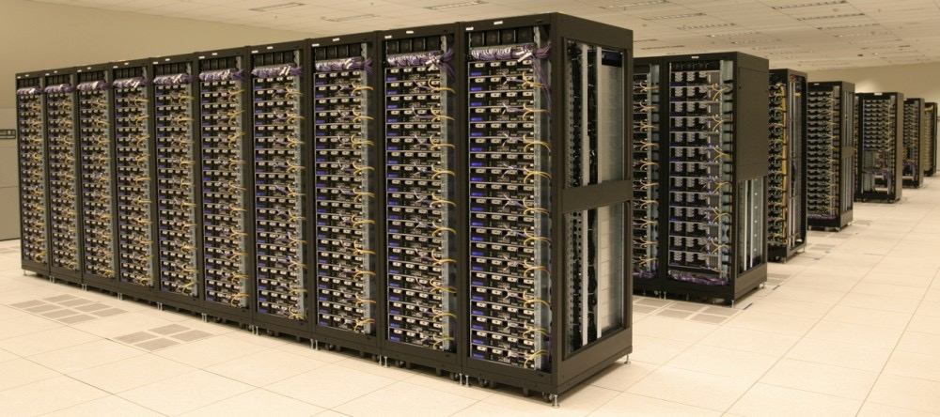
Apache Hadoop
Notes:
Hadoop cluster at Yahoo

Slide 8
Cloudera
Commercializes Hadoop* technology
Open source, open culture
CDH - Cloudera’s Distribution for Hadoop
Platform. Open source
Cloudera Manager (CM), Cloudera Navigator, Key Trustee
Cluster management, monitoring. Proprietary
*Hadoop and its associated projects
Notes:
Health care, telecom, retail, tech, media, government,

Slide 9
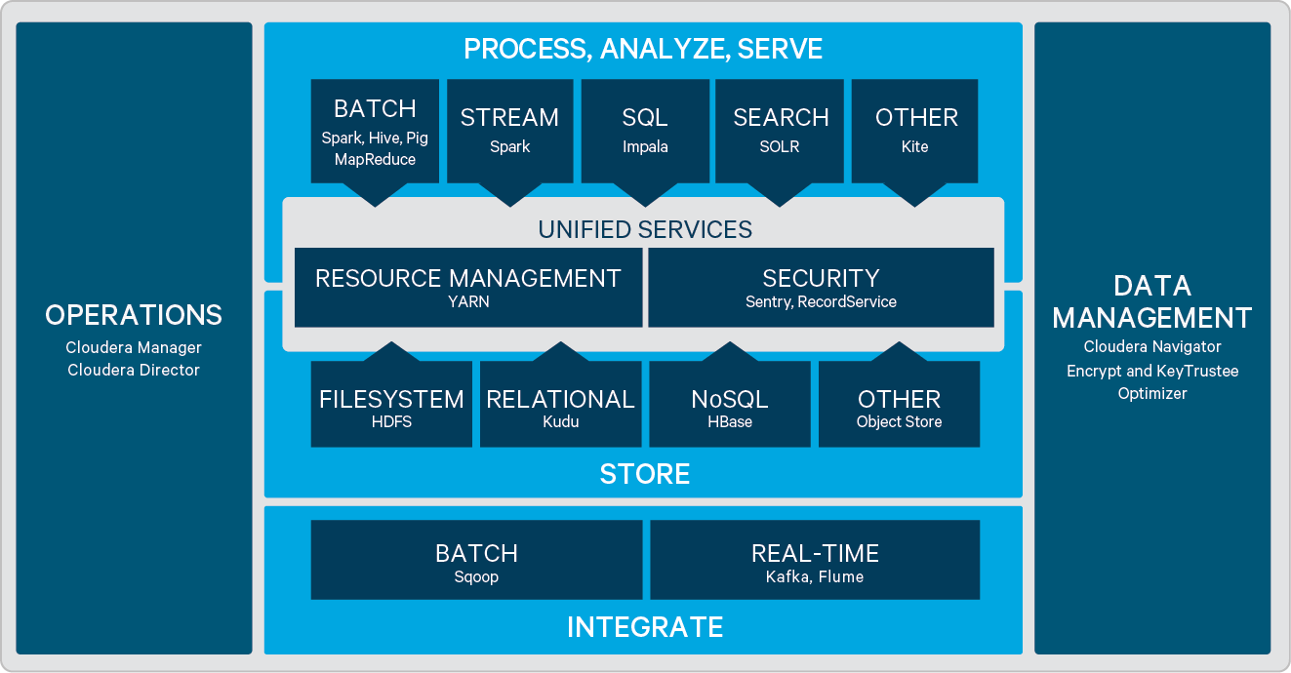
Hadoop Ecosystem
Notes:
This is Cloudera’s view of the Hadoop ecosystem.
Of course, other Hadoop distributions or platform distributions may have other views of the system. (Confluence, Databricks, Datastax

Slide 10


Well, data itself is a problem ...
Clusters becoming larger
More enterprise adoption
New applications
Storage: reduce storage cost
Compute: much larger cluster
High availability
High performance
Seamless experience
More cloud usage
Ease of development
Notes:
I am not talking about big data application, but big data management problem.

Slide 11
HDFS Erasure Coding

Slide 12


Hadoop Distributed File System
A fault tolerant, highly scalable storage system
POSIX semantics
Security — user authentication, authorization, at-rest encryption, transport encryption
3x replication
NameNode
DataNode
write
read
Notes:
Use commodity hardware means failure is a norm. Must handle it.
HDFS is a distributed file system -- high throughput
Traditionally replicated block architecture

Slide 13
Hadoop Distributed File System
Advantage
Failure tolerant
But
3x storage cost
3x datacenter space
3x power consumption
How to reduce storage overhead?
Notes:
As cluster grows, there are more cold data.
These cold data doesn’t need high through. They just need redundancy.

Slide 14
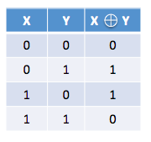
Erasure Coding 101
Parity bit
XOR
If X is lost, X can be reconstructed using Y and X ^ Y
50% overhead ((3-2)/2)
Can tolerate one failure
Reed–Solomon
RS(k,m) tolerates m failures in k data cells.
XOR = RS(2,1)

Slide 15
Erasure Coding 101
K blocks
Reed-Solomon
Compute parity bits for redundancy
Blocks can be reconstructed after failures
Configurable durability v.s. storage overhead
RS(6,3)
= 50% storage overhead
(9-6)/6
encode
M parity blocks
Notes:
http://blog.cloudera.com/blog/2015/09/introduction-to-hdfs-erasure-coding-in-apache-hadoop/

Slide 16
HDFS-EC: RS(6,3)
block
strip 1
parity 1
strip 2
parity 2
strip 3
parity 3
strip 4
strip 5
strip 6
read
write
Notes:
Traditionally replicated block architecture

Slide 17
HDFS-EC: Failure Handling

Slide 18
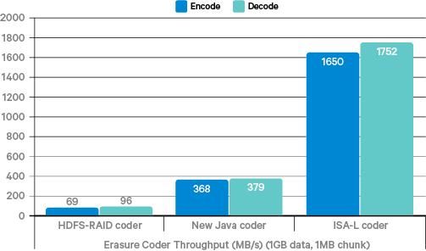
Notes:
The encoding/deciding of EC requires hardware acceleration ISA-L (4x speedup).
Intel folks has contributed significantly in this project.
Compare Facebook’s HDFS-RAID coder, pure Java coder, ISA-L coder

Slide 19
YARN Federation

Slide 20
YARN
A resource management framework for Hadoop clusters
Highly scalable, 4000 - 8000 nodes in production
Hive, Oozie, Spark, …
HBase
Notes:
Think of operating system kernel scheduler that runs multiple processes on multicore.
YARN-2915 https://issues.apache.org/jira/browse/YARN-2915

Slide 21
YARN
Application Master
Resource Manager
Client
Node Manager
Notes:
Think of operating system kernel scheduler that runs multiple processes on multicore.
YARN-2915 https://issues.apache.org/jira/browse/YARN-2915

Slide 22
YARN Federation
Developed by Microsoft
Extreme scale
100,000 compute nodes
Resource Manager becomes the bottleneck

Slide 23
YARN Federation
Application Master
RM 2
RM Proxy
RM 1
Application Master

Slide 24
YARN Timeline Service v2
Notes:
http://www.slideshare.net/NaganarasimhaGarla/application-timeline-server-past-present-and-future-53027238

Slide 25
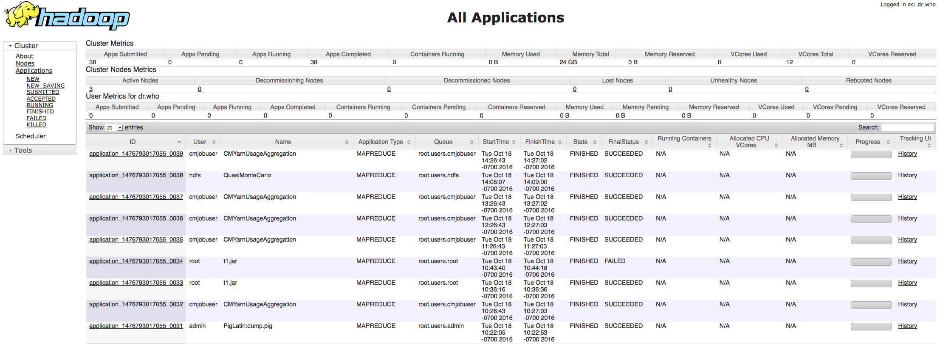
Job History Server
Keeps track of job progress
Collect or retrieve information of MapReduce jobs
Extensibility
MR only
Usability
No YARN level events
Metrics can only be retrieved after job terminates
Notes:
Each application has its own JHS. Information is not shared between each JHS.
It is hard to trace an oozie workflow, say it starts a spark job, runs hdfs command, start a yarn app. Very little visbility of global picture.
metrics is stored in HDFS. Can only be retrieved when job terminates.

Slide 26
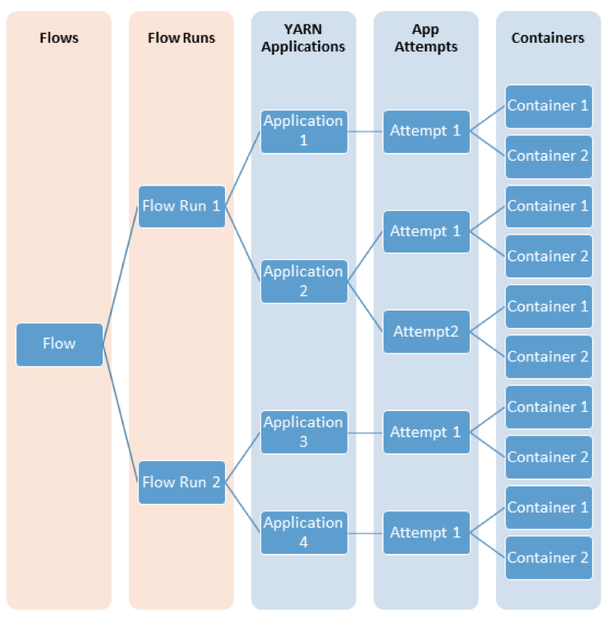
Application Timeline server v2
Development led by Twitter
Usability
Flow: logical group of applications
Scalability
HBase
Use cases
Analyze application performance.
Cluster capacity planning.

Slide 27
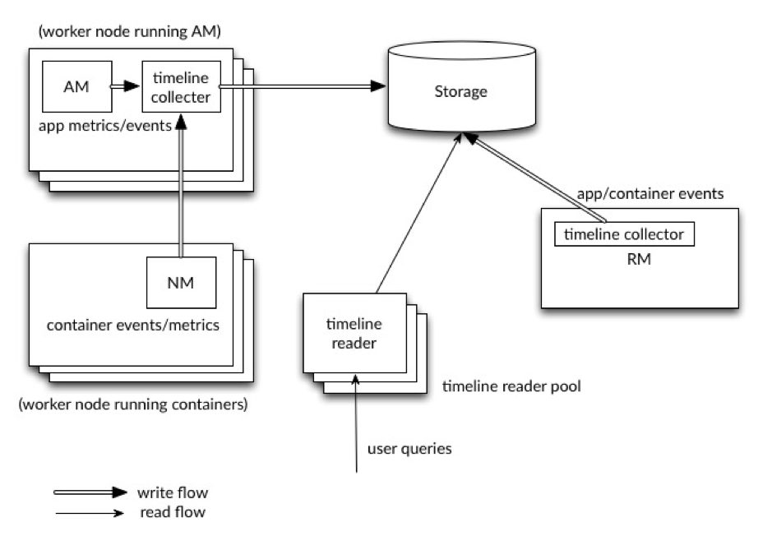
ASTv2 Architecture
Use HBase for storage
Use cases:
Analyze application performance.
Cluster capacity planning.

Slide 28
HDFS Multi Standby NameNodes
Notes:
Single point of failure
HDF-6440, contributed by Salesforce

Slide 29
NameNode High Availability
Quorum
Journal
Node
Active NameNode
Journal
Node
Upload fsimage
Standby NameNode
Client
Journal
Node

Slide 30
Multiple Standby NameNode
Quorum
Contributed by Salesforce.
Journal
Node
Standby NameNode
Upload fsimage
Journal
Node
Active NameNode
Client
Upload fsimage
Journal
Node
Standby NameNode
Notes:
Don’t go more than 3~5 nematodes in practice.

Slide 31
HDFS Intra Datanode Balancer

Slide 32
Data Imbalance
High density DataNodes has dozens of hard drives (volume)
Existing block placement policy is not sufficient to eliminate “hotspots”
Most new blocks will be written to a new volume.
DataNode throughput throttled by the volume throughput.
HDFS balancer does not help, either.
hotspot

Slide 33
Disk Balancer
Proactively balance between volumes on the same DataNode
$ hdfs diskbalancer
Available since CDH5.8.2

Slide 34
Classpath Isolation

Slide 35
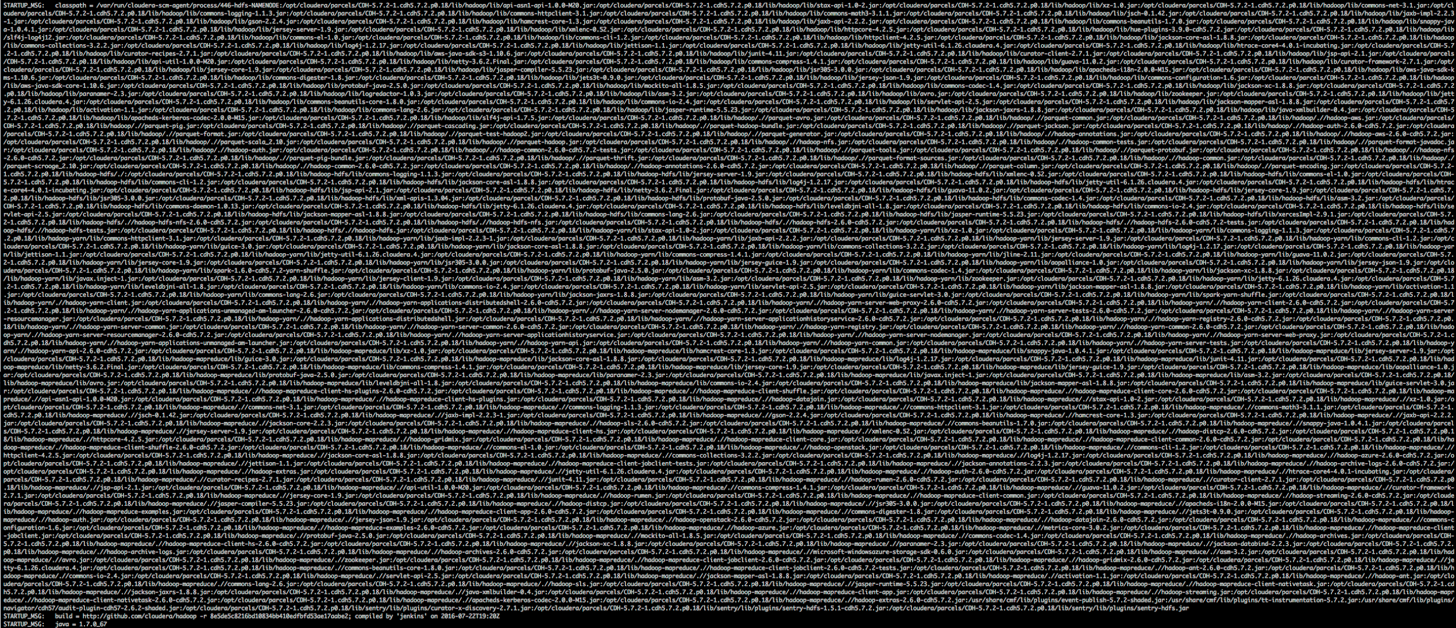
Dependency Hell

Slide 36
Dependency Hell
Hadoop was not initially designed as foundation of many applications.
More applications depending on Hadoop
harder for Hadoop to upgrade dependency libraries.
Potential risk to break existing applications
Increase exposure to security vulnerabilities
Classpath Isolation
Separate client-side classpath from server-side

Slide 37
Cloud

Slide 38
Other features
Cloud connectors
Microsoft Azure Data Lake filesystem
Aliyun Object Storage Service
Notes:
s3n will not be maintained other than security fix

Slide 39
Misc.

Slide 40
Other features and incompatibility
Shell script rewrite
Requires Java 8
Server ports
Remove legacy features
S3 file system → S3A (recommended) or S3N
Hftp → webhdfs/httpfs
Bookkeeper Journal Manager → Quorum Journal Manager
Notes:
s3n will not be maintained other than security fix

Slide 41
What’s next?

Slide 42

Now what?
Developers
Use it early, test it early and file bug reports.
Administrators
Test upgradability
Users
Expect better user experience.
2017/0?
CDH6
2016/09
2016/12
2017/0?
?
2017/01
Hadoop 3 Timeline
Alpha 1
Alpha 2
Alpha 3
Beta 1
GA

Slide 43

Future? Hadoop 4?
We don’t know yet.
Ozone (HDFS-7240)
Object store for HDFS
HDFS over cloud (HDFS-9806)
Emerging applications and use cases
Docker
Deep learning
Hardware Trend
Cloud storage
Faster ethernet (40GBps), high density (> 100TB) storage node
Memory technology
Locality will not be a deciding factor.
Notes:
Spend 10 minutes
Hadoop was based on the assumption to move compute to data
3D XPoint memory technology
Virtualized compute, storage and networks

Slide 44
Ozone (HDFS-7240)
Status quo
NameNode is becoming a bottleneck
A general file system may not suit the specific need of an application
Solution
Split HDFS namespace into blob stores
Notes:
Hortonworks

Slide 45
HDFS over Cloud (HDFS-9806)
Use case
Use HDFS for temporary data
Use cloud for permanent storage
The problem
Data management
Consistency
Solution
HDFS as metastore and cache
Cloud as backend data store
Notes:
Microsoft

Slide 46
Ask Bigger Questions
Notes:
Ask bigger questions

Slide 47
References
Introduction to HDFS Erasure Coding in Apache Hadoop
Enable YARN RM scale out via federation using multiple RM's
Application Timeline Server - Past, Present and Future
HDFS-6440 Support more than 2 NameNodes
How-to: Use the New HDFS Intra-DataNode Disk Balancer in Apache Hadoop

